Slide 1
GENERAL ASPECTS OF INJECTION
BY
DR.G.AARTHIPRIYANKA
POST GRADUATE
DEPARTMENT OF PHARMACOLOGY

Slide 2
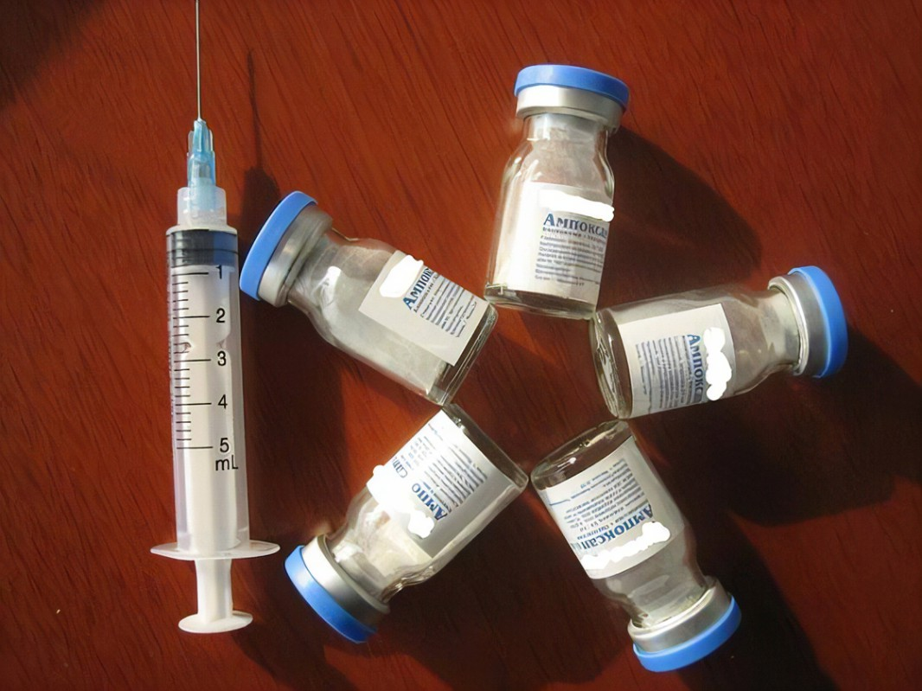
DEFINITION
Injections are parenteral dosage forms available as liquids in the form of solutions, suspensions, emulsions & oils or as dry soluble/insoluble powders ready to be combined with a solvent/vehicle just prior to use.

Slide 3
CONTAINERS FOR INJECTION
AMPOULES – sealed glass/plastic container meant for single dose
VIALS - sealed glass/plastic container which contain multiple doses
CONTAINERS FOR IV INFUSION – bottles, flexible plastic bags
PRE FILLED CARTRIDGES/SYRINGES

Slide 4
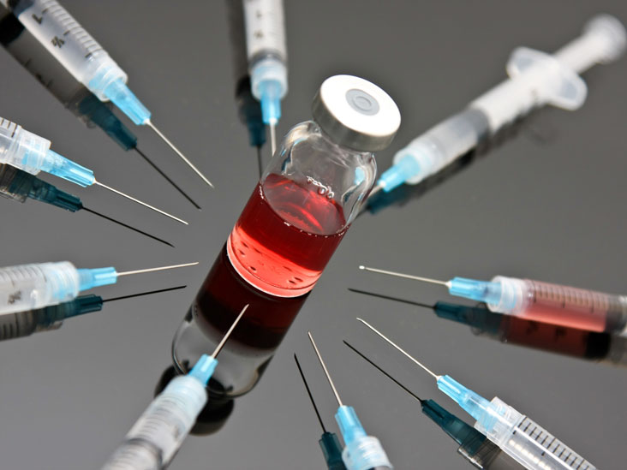
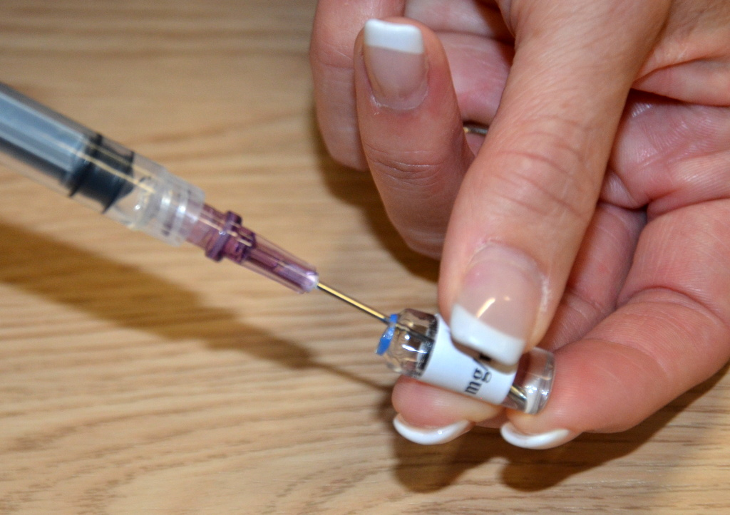

Slide 5
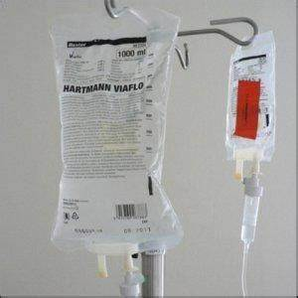
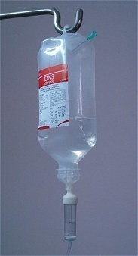
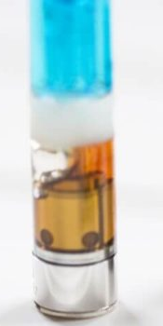
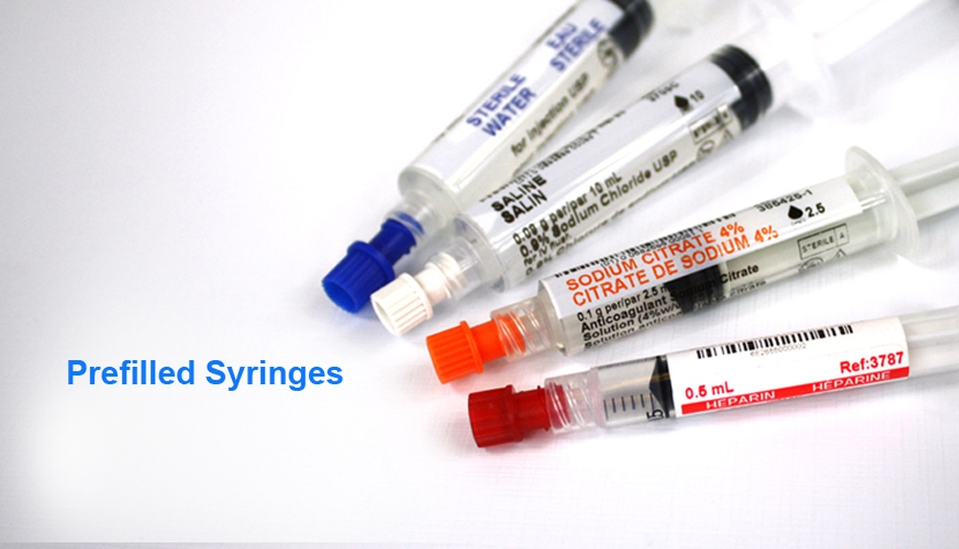

Slide 6
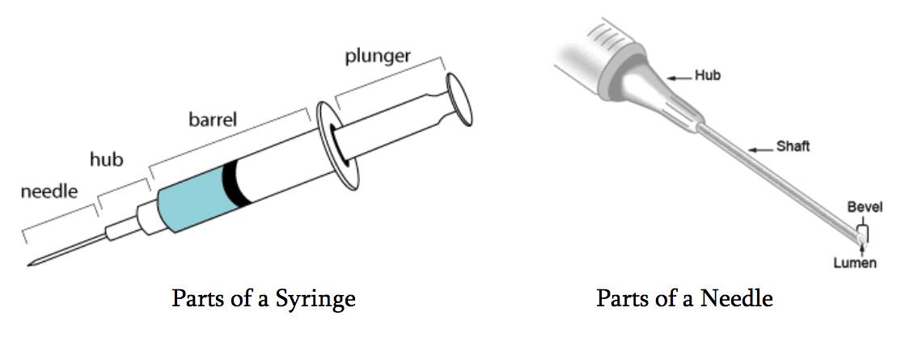
SYRINGE
Made of glass/polymer(plastic)
PARTS :
BARREL – used for holding medicament.
- has small graduations in cc/ml.
- insulin syringe graduations are in units (100 units/1ml)
TIP – to attach needle
PLUNGER ROD – piston type rod that moves within syringe barrel
VOLUME OF SYRINGES – 1,3,5,10,20,30,60 ml

Slide 7
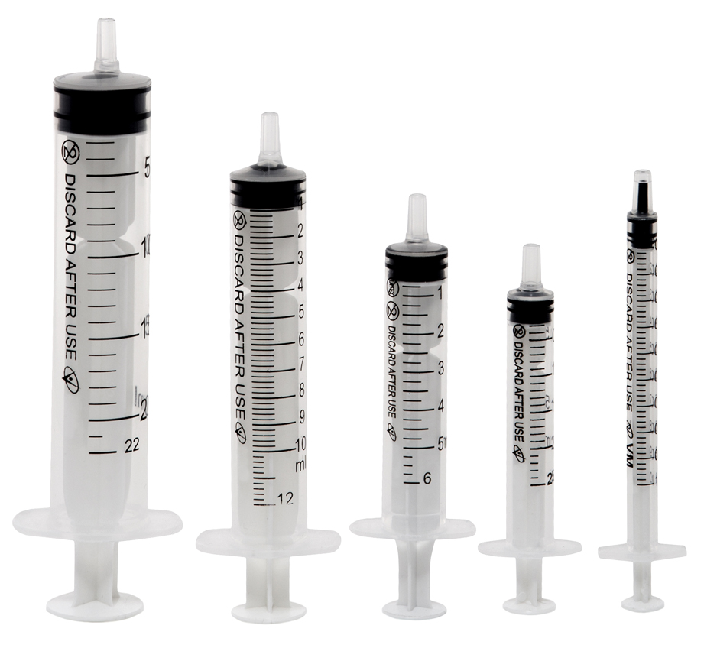
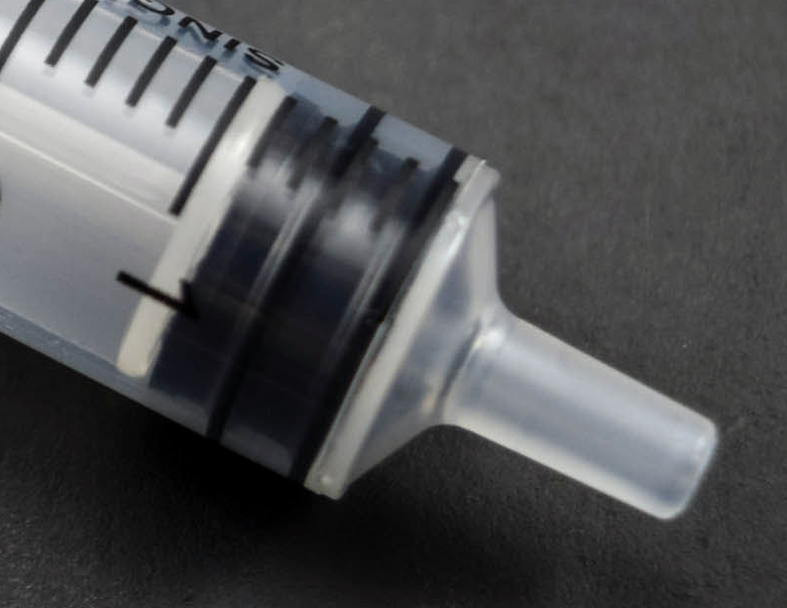
TYPES OF SYRINGES
NORMAL LUER SLIP SYRINGE:
Allow a needle to be pushed on to the tip for easy installation/removal

Slide 8
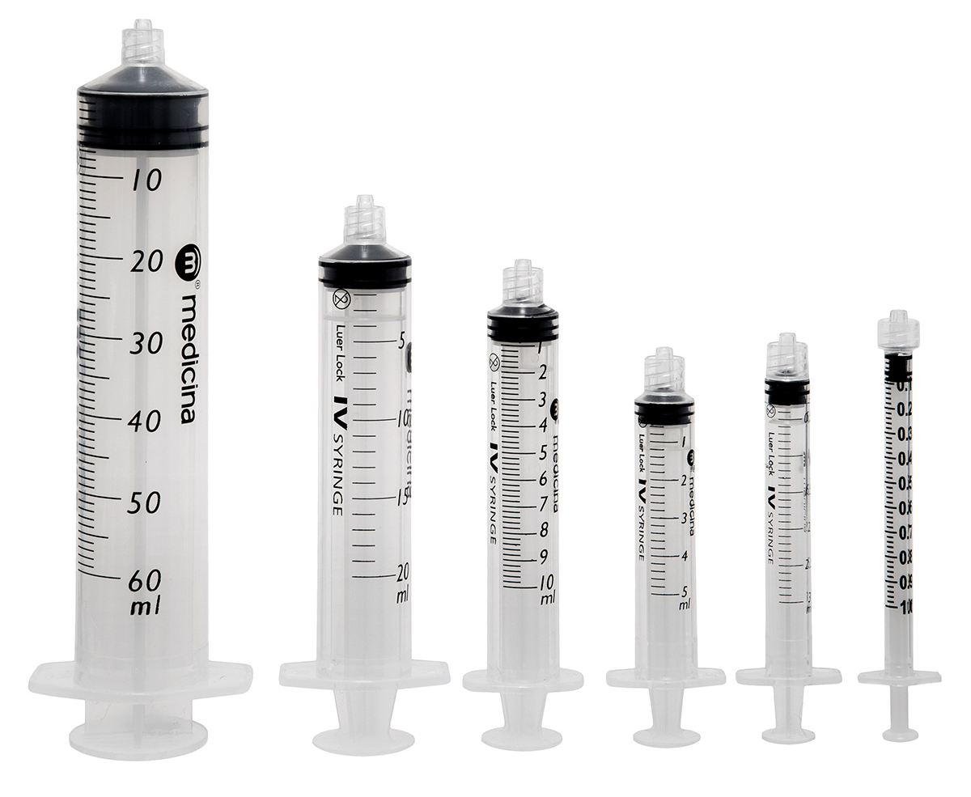
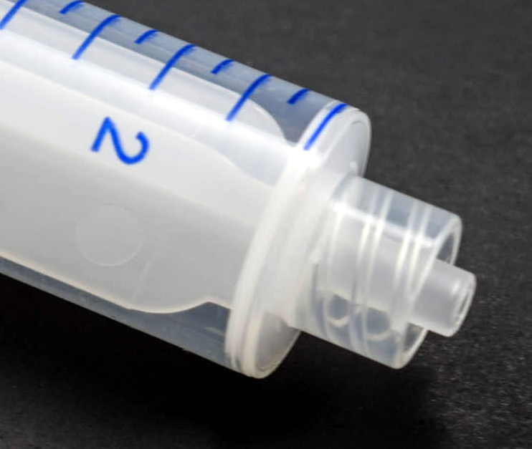
LUER LOCK SYRINGE
Has a threaded tip that allows for luer lock needles to be screwed
Provide a secure connection

Slide 9
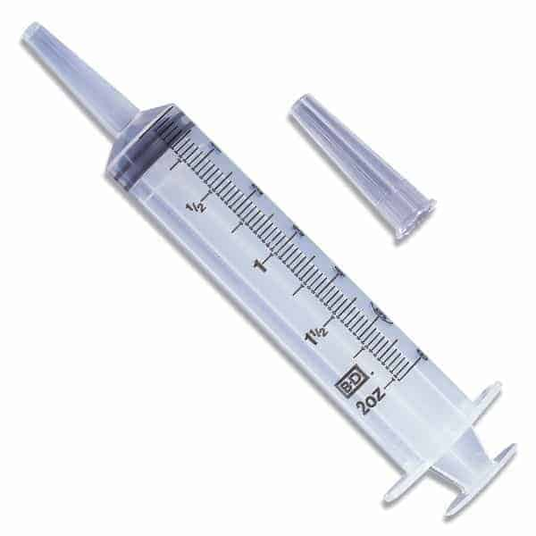
CATHETER TIP SYRINGE
Slip tip is larger than the standard slip tip
Used for injection through tubing

Slide 10
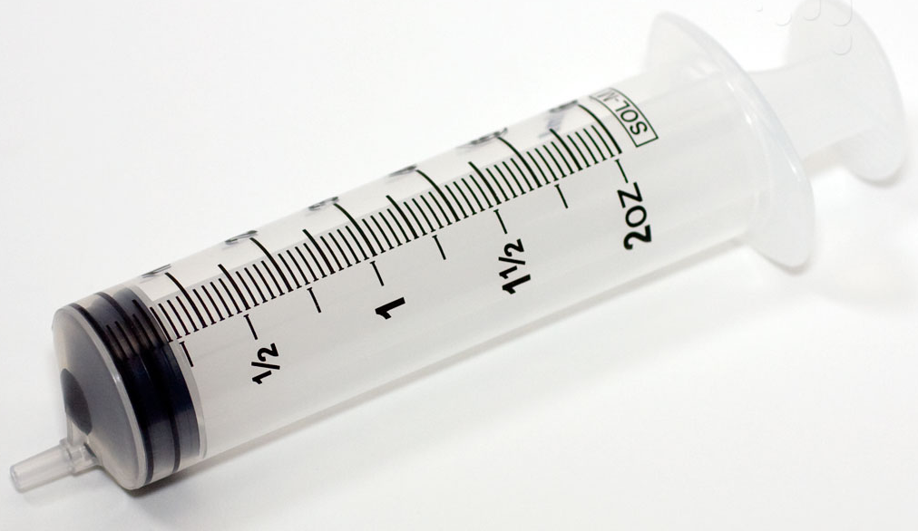
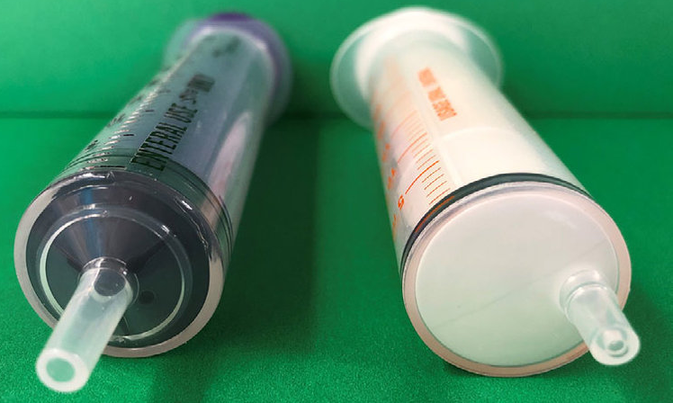
ECCENTRIC TIP SYRINGE
Tip is line with the outer body of the barrel
Used to inject parallel to the skin

Slide 11
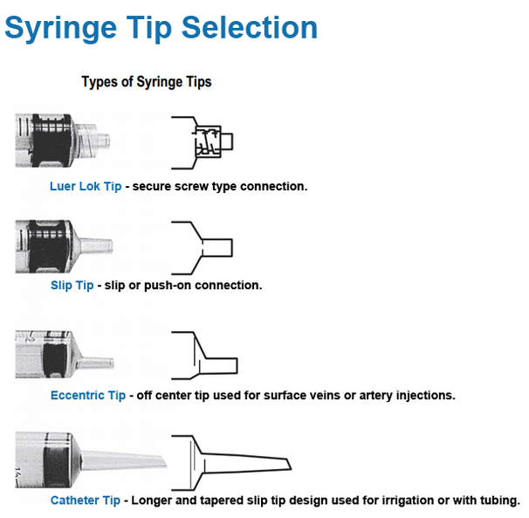

Slide 12
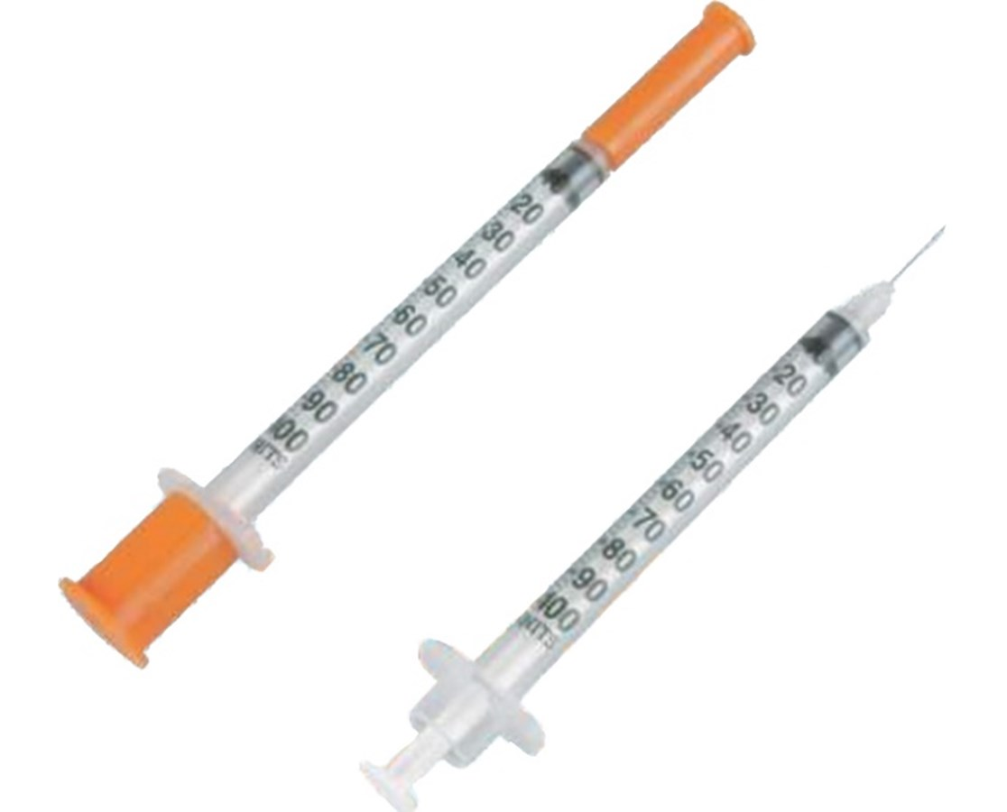
SYRINGE WITH ATTACHED NEEDLE
INSULIN SYRINGE
Provided with Non-detachable, Finer Gauge needle of small length for less pain

Slide 13
PREPARATION OF THE PATIENT
Introduce yourself
Approach the patient in a friendly, calm manner
Explain the procedure you are going to do to allay his/her apprehension if any, gain trust & co-operation
Provide privacy & dignity throughout the procedure

Slide 14
SAFETY CONCERNS
Check the patient’s detail
Ensure Vial/ampoule contains right drug in the right strength
Check the expiry date
Exact site selection is mandatory
All materials used in the procedure should be sterile
Wash your hands
Disinfect skin over injection site with alcohol swab
Do not touch anything with unprotected needle
Once injection has been given,take care not to prick yourself or somebody else to prevent needle stick injuries
Don’t try to remove,bend,break, or recap needles
Don’t put them into trash/recycling bin/toilet
Place needles & other sharps in a SHARP DISPOSABLE CONTAINER immediately
Syringes can be collected in a biohazard thick plastic bag

Slide 15
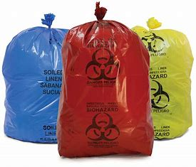
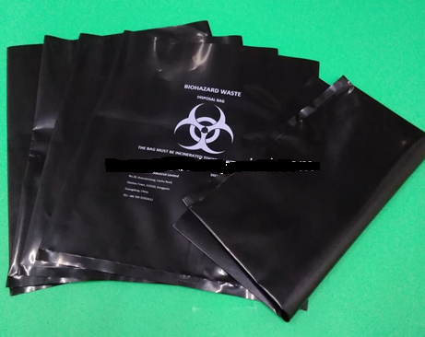

Slide 16


Slide 17
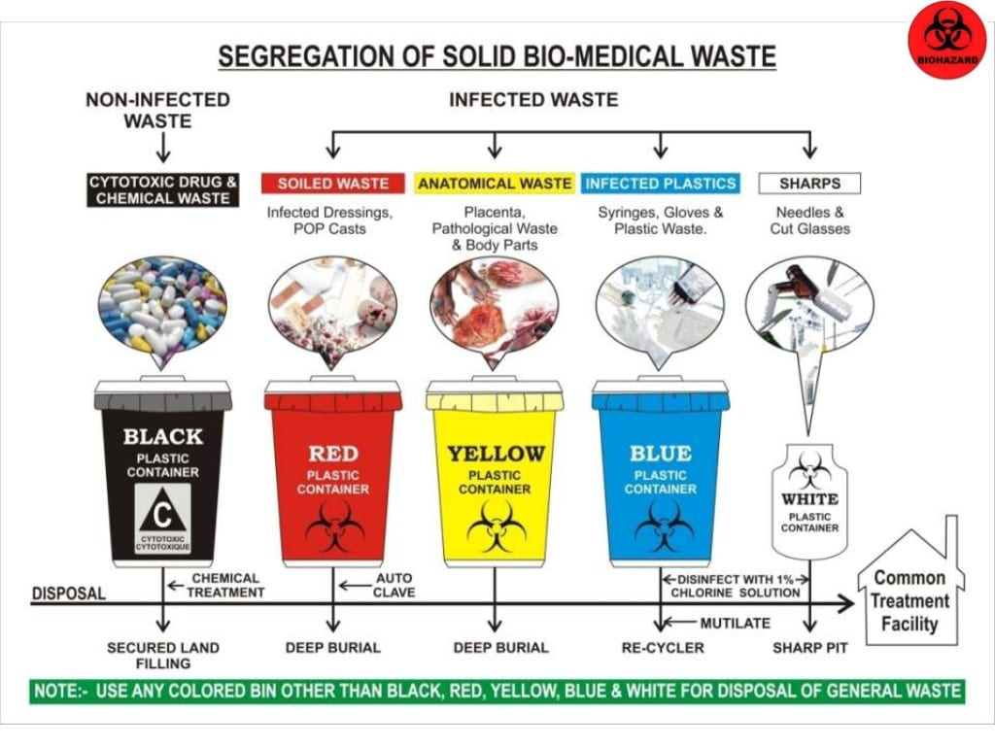

Slide 18
NEEDLE
HUB – at the end of the needle, attaches to syringe
BEVEL – slanted opening at end of needle
LENGTH – from juncture of hub to tip 3/8” to 3 & ½” (1cm to 4cm)
GAUGE – size of lumen from 32G (Finest) to 16G (Largest)
inner diameter from 0.23mm to 1.60mm

Slide 19
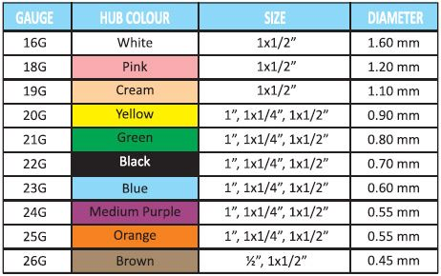
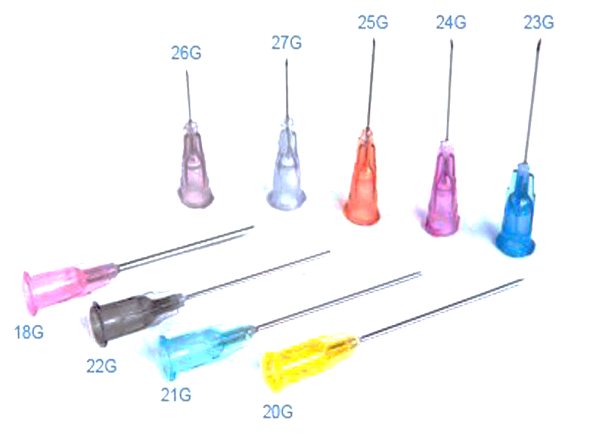

Slide 20
ASPIRATION FROM AMPOULE(GLASS,PLASTIC)
MATERIALS USED:
Ampoule with required drug,
syringe of appropriate size,
needle of right size,
alcohol swabs,
gauze

Slide 21
PROCEDURE
Wash your hands
Disinfect top of the ampoule
Put the needle on the syringe
Remove the liquid from neck of the ampoule by flicking it/swinging it fast in a downward spiraling movement
File around the neck, carefully. Break off the top of the ampoule (protect your fingers with gauze). For a plastic ampoule with the top.
Aspirate fluid from ampoule
Remove air from syringe
Clean up, dispose of working needle safely. Wash your hands.
Charge needle before administration/injection.

Slide 22


Slide 23
ASPIRATION FROM A VIAL
MATERIALS USED:
Vial with required drug,
syringe of appropriate size,
needle of right size,
alcohol swabs

Slide 24
PROCEDURE
Wash your hands
Remove the metal/plastic cap from the vial. Disinfect the exposed rubber cap
Put the needle on the syringe, suck up as much as air as the amount of solution needed to aspirate
Insert the needle into the vial through the centre of rubber seal & turn upside down
Inject air into vial (creating pressure)
Aspirate the required amount of solution. Make sure needle is below the fluid surface
Remove air from syringe
Clean up, dispose of working needle safely. Wash your hands.
Charge needle before administration/injection.

Slide 25
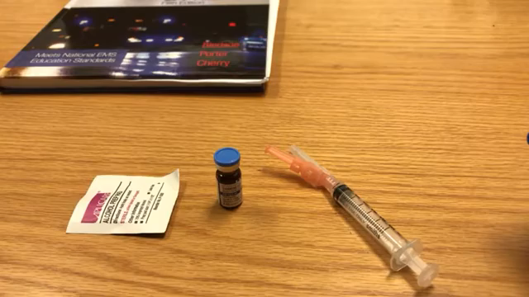

Slide 26
DISSOLVING DRY MEDICINE IN THE VIAL
Aspirate the right amount of solvent on a syringe
Inject the fluid into the vial & shake well after removing the needle
Aspirate the solution by repeating the above procedure

Slide 27
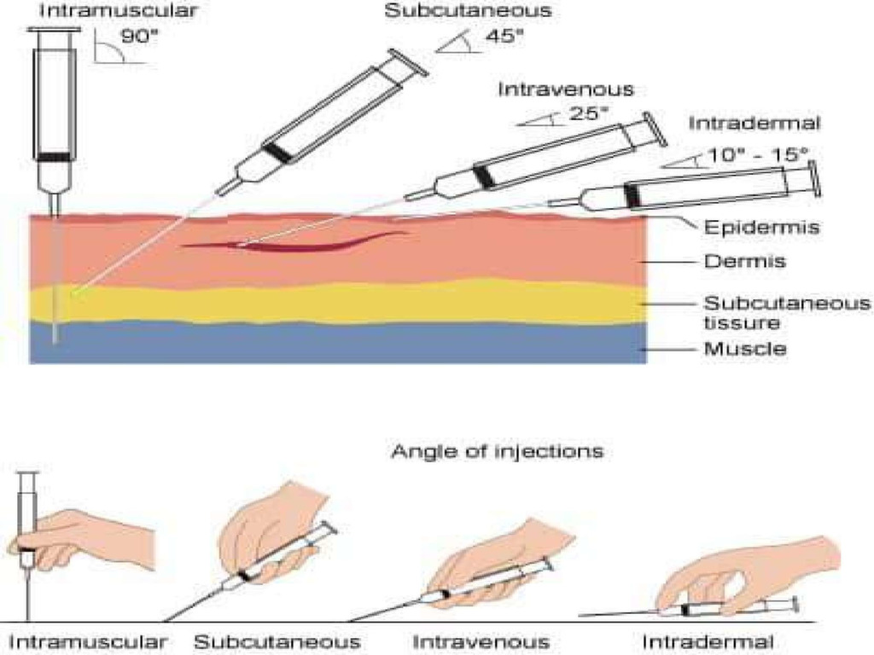
TECHNIQUES OF INJECTION

Slide 28
HOME WORK
What is needle stick injury?
How do you prevent needle stick injury & what are the immediate steps to be taken after needle stick injury
What are the diseases that spread by needle stick injury?
What lab tests are done after needle stick injury & how long after needle stick injury should we get tested?
Treatment protocol for needle stick injury?(both WHO & Indian protocol)
Name the different colours of bins/bags used for hospital waste disposal

Slide 29
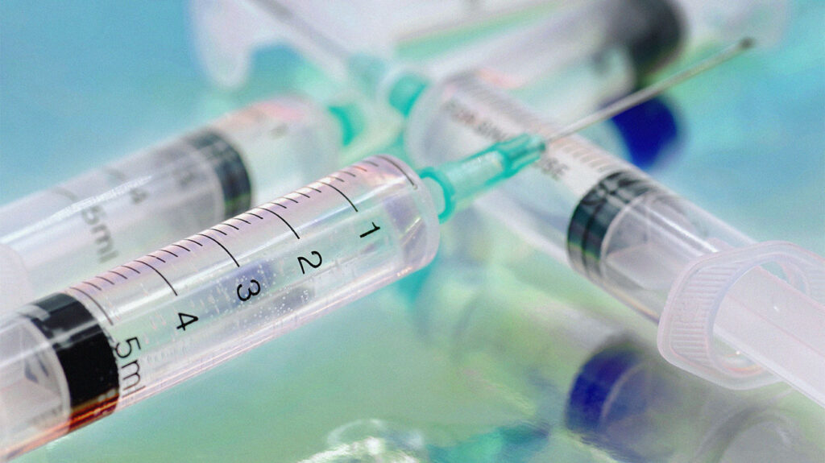
THANK YOU

